Slide 1
Instructions
READ ME!
Dear colleague,
Thank you for downloading this corporate PowerPoint template. This template will help you visualize your story so that your audience will remember it.
Before you start, please consider:
Are you going to use this presentation online? If that is the case, please use the dark-grey or 100% black version.
Are you going to use this presentation as a printed hand-out? Please use the white version.
Make sure that you have opened the template and will save your presentation in PowerPoint, NOT in OpenOffice. OpenOffice (like in Teams) disrupts the template, unfortunately.
After that, please browse through the different slide types the template offers. You can do that by clicking on the ‘new slide’ button above. Did you started with a slide, but do you want a different layout? Please click on the ‘layout’ button and select the slide type you prefer. You can find more tips on the first two pages of this template. You do not need to delete these slides as they are not visible in presentation mode; moreover, they might come in handy while building up your presentation.
Finally, please remember that the presentation should strengthen your story, not tell it.
Have fun!
.

Slide 2
Using text levels
Insert/change chart
Home
Text level up
1
If necessary, delete the existing chart by hitting the ‘Delete’-button. Click on the pictogram to insert a new chart. (see example below).
Text level down
Under the tab ‘Home’, use the list level-buttons, as pictured above, to choose a text level. Choose from:
1
Bullet
2
Select the preferred chart and click ‘Insert’.
2
Sub-bullet #1
Insert
3
Sub-bullet #2
4
Numbering
3
Change the layout of the chart by clicking on parts of the chart and go to the 'Format' tab.
5
Numbering #2
Format
6
Numbering #3
7
Subtitle
Edit data of Chart
8
Standard paragraph
1
Select the chart, click with the right mouse button and choose ‘Edit data’
9
Standard paragraph
Change chart type
Edit data
.

Slide 3
Insert/change image
Insert/change video
1
If necessary, delete the existing image by hitting the ‘Delete’-button. Click on the pictogram to insert a new image. (see example below).
1
If necessary, delete the existing image/video by hitting the ‘Delete’-button. Click on the pictogram to insert a new video. (see example below).
2
Select the preferred image and click ‘Insert’.
2
Select the preferred video and click ‘Insert’.
Insert
Insert
3
To scale or drag the image, go to the tab ‘Picture Tools - Format’ and click on the button ‘Crop’. Scale the image with the spheres and scale the image frame with the corners.
3
To scale or drag the video, go to the tab ‘Video Tools - Format’ and click on the button ‘Crop’. Scale the video with the spheres and scale the video frame with the corners.
Crop
Crop
4
To reset the slide and get all placeholders back to their original place, click with the right mouse button on the miniature slide on the left side of the screen and choose ´Reset slide´.
Want to know more? Go to the slide named ‘Instruction slide: YouTube links’, open it in the slideshow and click on the preferred hyperlink.
Lay-out
Reset slide
.

Slide 4

Explaining values of doubtful reliability
Faculty of Electrical Engineering, Mathematics, and Computer Science
Quang-hung Nguyen
Supervisor: Maurice van keulen

Slide 5


motivation
Data is key to robust Machine Learning models
A framework to test the reliability of features
KEY IDEAS
Dataset with 20 features (X), and one target to predict (y).
Choose a feature (A)
Corrupt some row of feature A
Train an Xplainable model to predict feature A from 19 other features.
How well can XAI model detect the corruption?
Does the corruption tells anything about feature reliability?
.

Slide 6
Research question
Research gap: No paper has attempted to train ML models to predict features for reliability testing. Most other related works are on Computer Vision and/or Classification.
RQ: How well can a machine learning model detect and explain feature reliability based on related attribute, when that feature is corrupted?
Sub-RQ: To what extend the corruption can be detected and explained (How many % of corruption)?
Sub-RQ: How well does the model distinguish between original doubtful values and corrupted values?
.

Slide 7
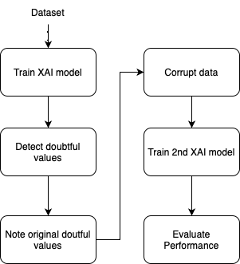
methodology
overview
.

Slide 8
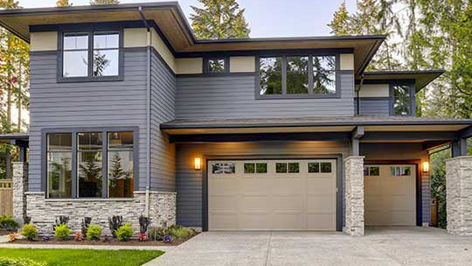


methodology
dataset
Kaggle house prices dataset
1500 rows, 81 features
Example features: House quality, number of bathrooms, neighborhood, heating quality, garage type, porches, Sale price, etc.
Explainable AI
Ridge Regression with Cross-Validation
Explaining Model with SHAP
evaluation
Confusion Matrix
Evaluating explanation based on CO-12 Framework - TBD
.

Slide 9
RESULTs
Up until
1500 rows, 81 features
Example features: House quality, number of bathrooms, neighborhood, heating quality, garage type, porches, Sale price, etc.
.

Slide 10
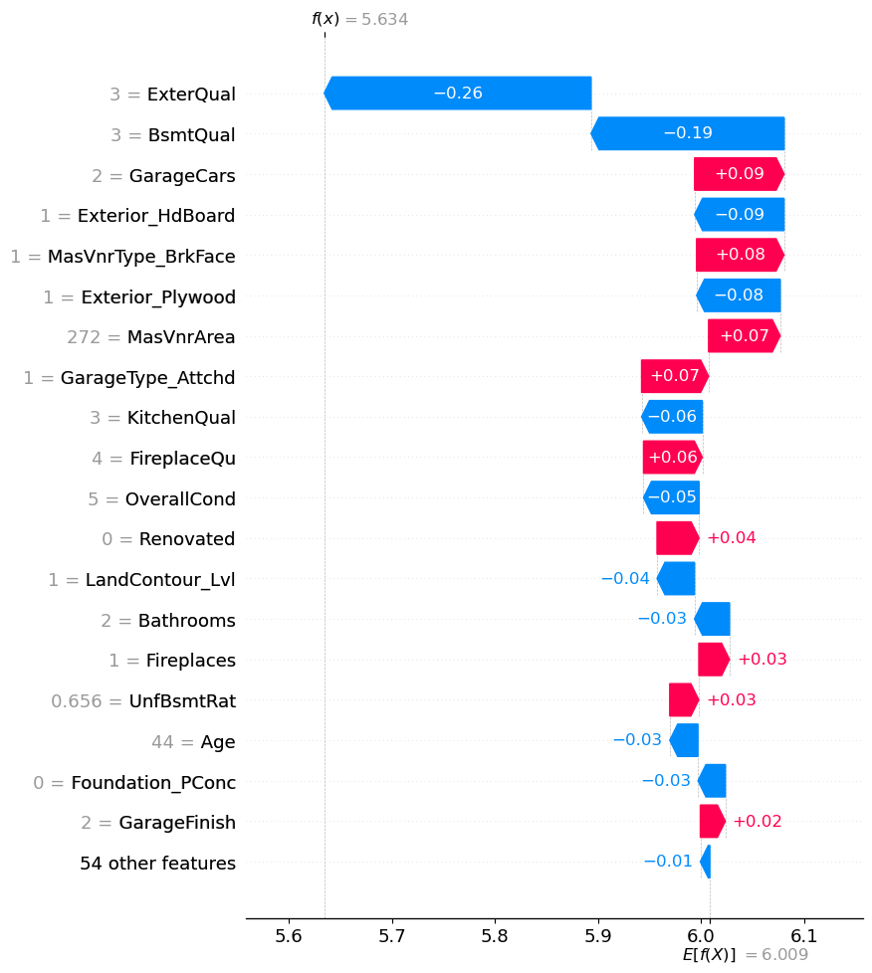
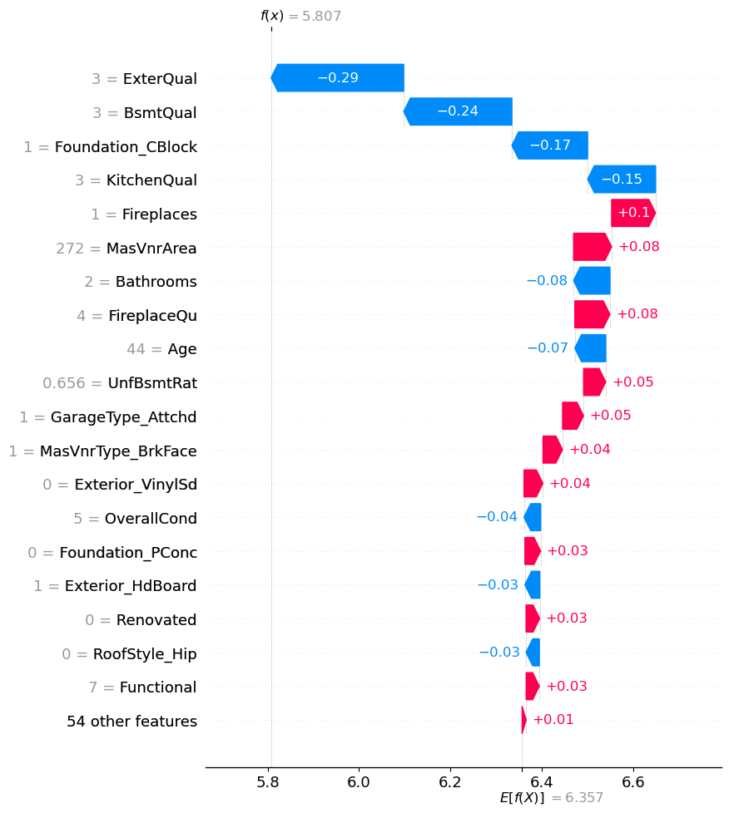
RESULTs
.

Slide 11
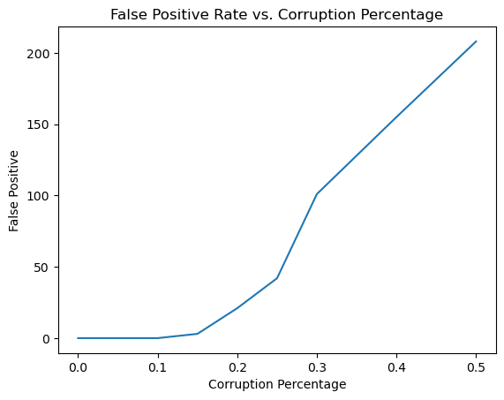
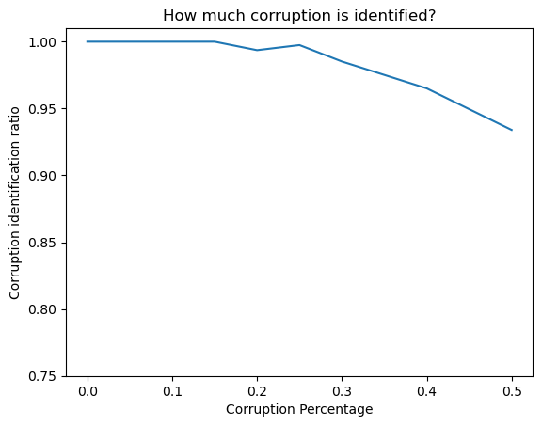
RESULTs
.

Slide 12
Thank you for listening
Quang-hung nguyen

